Slide 1
ECE GY 6913 Computing Systems Architecture
RISCV Simulator Project – Phase 1 and 2
Fall 2024

Slide 2
Goal of the Project
Have a working model of a 32 bit RISC-V interpreter.
Accurately maintain the values in all registers and memory locations.
Project is to be done either in Python or C++. The boiler-plate code will been provided on brightspace.
Project is to be done individually.

Slide 3
Grading Scheme and support
Weightage of the RISCV project will be 10% of your total grade.
Each phase (Phase 1 Single stage and Phase 2 Five stage) will be out of 50 marks
Test cases – total 10 – 3 of which will be released a week before submission of each phase.
Project report – contains questions and marking scheme which will be posted on Brightspace
Mondays 9:30 AM – 11:00 AM will be project office hours starting 7th Oct 2024
Phase 1 submission is on 8th Nov 2024, Phase 2 submission is due Dec 13th 2024

Slide 4
Input
imem.txt
contains binary input of all the instructions
dmem.txt
contains binary input of all the memory locations

Slide 5
Output
Performance Metrics
Register States after each cycle
DMem at the end of program execution
State Results

Slide 6
What needs to be done in IF
Read 4 lines of the IMEM file.

Slide 7
What needs to be done in ID
Convert the 32 bits into an instruction. (Big endian)
00000000
01010010
00000001
10110011
Instruction: 00000000010100100000000110110011
Decoded instruction: add x3, x4, x5

Slide 8
What needs to be done in EX
Instruction: add x3, x4, x5
lw x10, 20(x12)
Be sure to perform the right execution at this stage.
R and I type instructions will perform the normal executions.
Load and Store instructions will perform calculations of offset.

Slide 9
What needs to be done in MEM
Make sure to access memory in this stage.
LOAD and STORE instructions

Slide 10
What needs to be done in WB
Update the values of registers in this stage.
Eg. loading a value into a register, arithmetic result to be written into register

Slide 11
Instructions to be implemented
Please refer Brightspace Project document which contains all instructions that need to be implemented.

Slide 12
Common Question – Why extra cycle?
State after executing cycle: 0
IF.PC: 4
IF.nop: False
----------------------------------------------------------------------
State after executing cycle: 1
IF.PC: 8
IF.nop: True
----------------------------------------------------------------------
State after executing cycle: 2
IF.PC: 8
IF.nop: True
There is always an extra cycle at the end after If.nop is set to true
Refer the code to see how self.halted is set to true in the code
Checkout where our print statements for each cycle are.
Simple example:
ADD x2, x3, x1
HALT
Number of instructions = 2, cycles = 3

Slide 13
Hazards – EX to 1st
add x5, x2, x3
add x6, x5, x4
1 2 3 4 5 6
IF ID EX ME WB
IF ID EX ME WB

Slide 14

Hazards – EX to 2nd
add x5, x2, x3
sub x7, x8, x9
add x6, x5, x4
1 2 3 4 5 6 7
IF ID EX ME WB
IF ID EX ME WB
IF ID EX ME WB

Slide 15

MEM to 2nd
lw x5, 20(x10)
sub x7, x8, x9
add x6, x5, x4
1 2 3 4 5 6 7
IF ID EX ME WB
IF ID EX ME WB
IF ID EX ME WB

Slide 16
MEM to 1st
Cannot forward since they are both in the same cycle.
Use NOP
NOP halts one stage of the pipeline
lw x5, 20(x10)
add x6, x5, x4
1 2 3 4 5 6
IF ID EX ME WB
IF ID EX ME WB
1 2 3 4 5 6 7
IF ID EX ME WB
IF ID NOP EX ME WB

Slide 17
Test Case 1
0 1 2 3 4 5 6
Lw IF ID EX ME WB
Lw IF ID EX ME WB
Add IF ID ---- EX MEM WB
Sub IF ---- ID EX MEM WB
SW ---- IF ID EX MEM

Slide 18
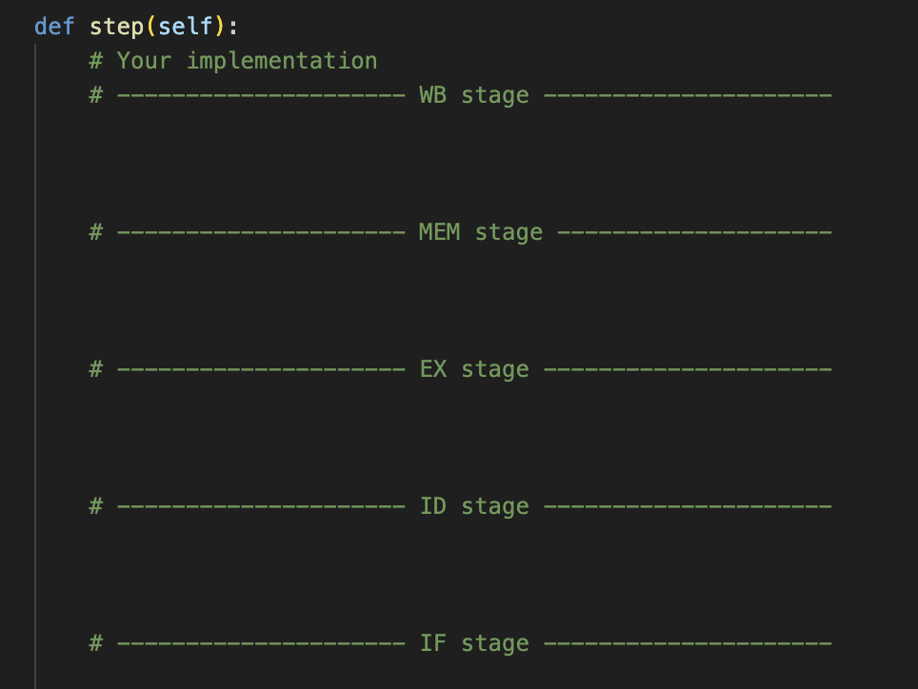
Why are the stages in reverse order in code?
If implementing a NOP say in the EX stage, every lower state (before the EX stage) will be in NOP till the upper state NOP is resolved.
Essentially the lower states are affected by the upper states.

